Slide 1

PRESENTATION ON
MOVIE RECOMMENDATION SYSTEM
(USING CONTENT BASED FILTERING)
Presented By:
Sushree Sangeeta Jena
PGDA27

Slide 2

CONTENTS
01
Problem Statement
02
Dataset Description
03
Methodology
04
Key Findings
05
Real World Implications

Slide 3

PROBLEM STATEMENT

Slide 4
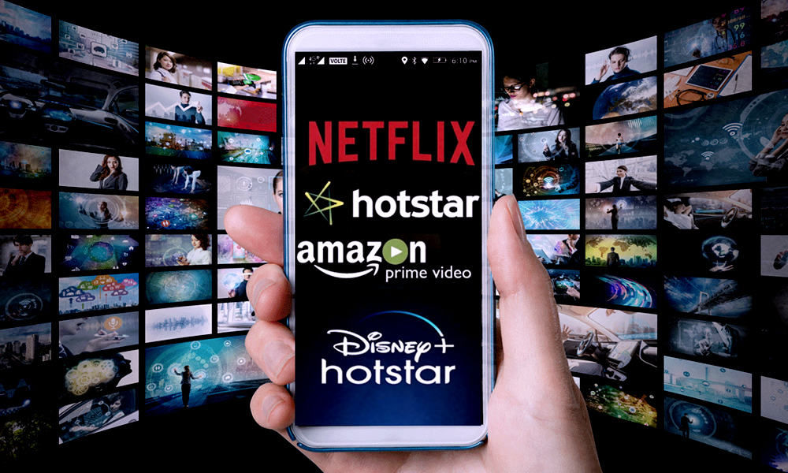
OTT movie platforms have gained momentum and are the most commonly used for streaming movies and TV shows. Since, they are easily accessible and provide comfortable streaming services to the users, it has become very popular and has become a profitable business.
But with increasing competition, it becomes difficult to retain a viewer to one particular platform. One of the key factors here is to suggest similar movies/shows based on his past history, so that he will be likely to watch those movies also.
Then comes the importance of recommendation engines to find the most similar movies so that we can retain the customer to our platform.
So, we are required to build a recommendation system (using content based filtering technique) to suggest similar movies to our customers.

Slide 5
DATASET DESCRIPTION

Slide 6

Context:
This dataset contains information about different movies collected over a period of time. It has 4809 records in total. It has 22 features taken into consideration.
Objective:
To build a movie recommender system using recommendation algorithms like content based filtering.

Slide 7
Attributes:
Credits File Attributes:
Movie_id: Id specific to a movie
Title: Title of the Movie
Cast: Information about all the actors in the movie
Crew: Information about all the crew members. For eg.Director,Producer,Art, Sound,etc. for the particular movie
Movies File Attributes:
Budget: Total Movie Budget
Genres: Categorizing the movie into classes like Thriller, Romance, Action, etc.
Homepage: Link to the movie
Id: Id specific to a movie
Keywords: A group of words to easily collect information about the movie

Slide 8
Attributes(contd.):
Original_Language: Original Language in which the movie was released
Original_Title: Original Title of the Movie
Overview: Description of the movie
Popularity: Popularity score given by the users
Production_Companies: Information about who produced the movie
Release_Date: Release date of the movie
Revenue: Total amount collected by box office
Runtime: Length of the movie
Spoken_Languages: Other languages where the movie was dubbed
Status: Released/Not Released
Tagline: Movie Tagline
Title: Title of the movie at the time of release
Vote_Average: Average votes given by the viewers
Vote_Count: Total votes given by the viewers

Slide 9
METHODOLOGY

Slide 10
02
Data Cleaning
01
03
05
Dataset Preparation
Vectorization
Movie Recommendation System
04
Calculating Similarity Score

Slide 11
Merging the two datasets-Movies and Credits Dataset
Features Selected based on the words which are used frequently by the viewers to search for a movie
Checking for null values in the selected features and replacing it with a null string
Creating a backup
01
Dataset Preparation
Features: genres, keywords, overview, cast, crew

Slide 12
02
Data Cleaning
01
03
05
Dataset Preparation
Vectorization
Movie Recommendation System
04
Calculating Similarity Score

Slide 13
Parsing the required words for the Genres and Keywords column using ast library
Parsing the top 3 members for the Cast column
Parsing the name of the director from list of crew members column
Removing space in between words from all the above mentioned columns
Joining the individual words into a group of words
Creating combined_features by using all the selected features columns
Creating a backup
Adding a new column movie_index for ease of accessing movies
02
Data Cleaning

Slide 14
02
Data Cleaning
01
03
05
Dataset Preparation
Vectorization
Movie Recommendation System
04
Calculating Similarity Score

Slide 15
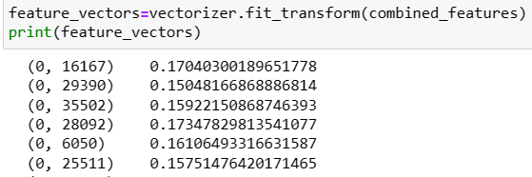
Using TfIdfVectorizer, we will convert the selected text to feature_vectors, so that the model can understand it
03
Vectorization

Slide 16
02
Data Cleaning
01
03
05
Dataset Preparation
Vectorization
Movie Recommendation System
04
Calculating Similarity Score

Slide 17
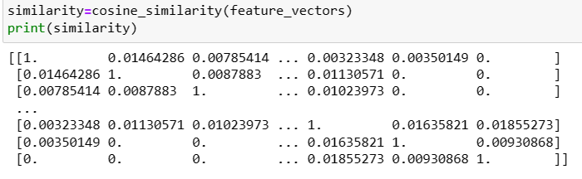
Using Cosine Similarity to find the similarity score between two movies
04
Calculating Similarity Score

Slide 18
02
Data Cleaning
01
03
05
Dataset Preparation
Vectorization
Movie Recommendation System
04
Calculating Similarity Score

Slide 19
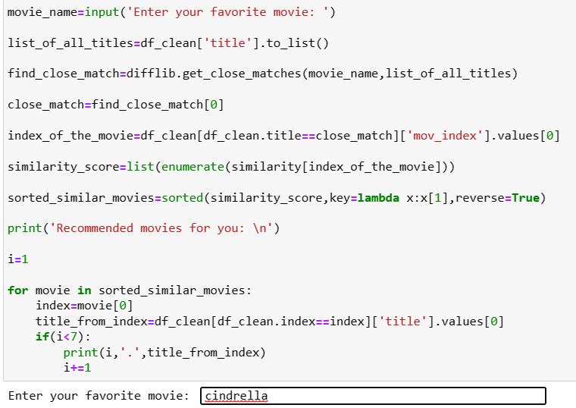
05
Movie Recommendation System

Slide 20
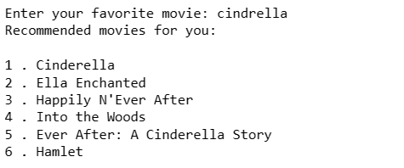

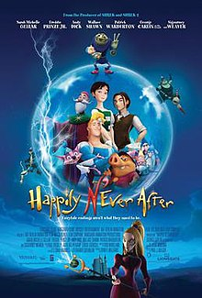



05
Movie Recommendation System

Slide 21
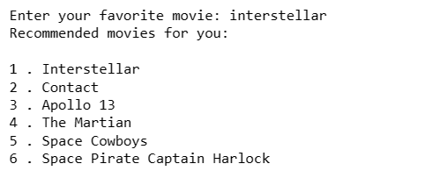
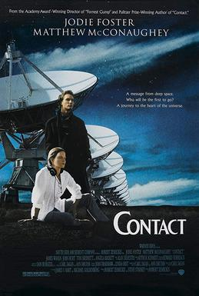
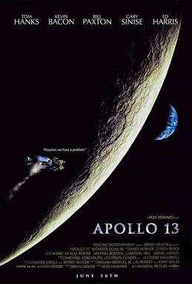

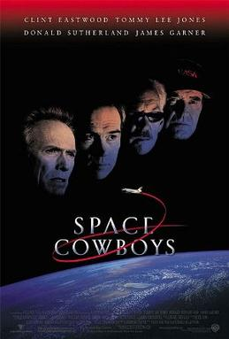

05
Movie Recommendation System

Slide 22
02
Data Cleaning
01
03
05
Dataset Preparation
Vectorization
Movie Recommendation System
04
Calculating Similarity Score

Slide 23
KEY FINDINGS

Slide 24

Advantages:
Content Based Filtering does not have the Cold Start Problem as Collaborative Filtering
No data from other users is required to start making recommendations
Recommendations are highly relevant and transparent to the users.
Disadvantages:
Scalability is a challenge
Attributes may be incorrect or inconsistent

Slide 25
REAL WORLD IMPLICATIONS

Slide 26
01
Recommendation Engines are widely used because of its ability to filter large chunks of data dynamically and provide users with personalized options.
02
It is beneficial for both service providers and users as it helps in reducing the transaction costs of finding and selecting an item.
03
It helps in customer retention and also help in enhancing revenues.

Slide 27

THANK YOU

